Slide 1
Economics of the School Marketplace
Navigating Disruptive Change in Enrollment Management, Pricing, and Financial Aid

Slide 2
Meet the Presenters
Heather Hoerle
Executive Director and Chief Executive Officer,
The Enrollment Management Association
Chad Tew Founding Principal and Disruption Navigator,
Tew & Associates
Laurel Baker Tew Assistant Head for Enrollment, Viewpoint School and Vice Chair,
Board of Trustees, The Enrollment Management Association
Jeffrey Shields
President and CEO of the National Business
Officers Association

Slide 3
NBOA / EMA Partnership
Explore issues related to:
+ Financial aid
+ Current market conditions
+ Pricing
+ Enrollment
+ Accessibility and affordability trends to help independent schools identify their most viable path forward amid dynamic change

Slide 4
Presentation Goals
+ Review Economic, Demographic, and Technological Forces Disrupting Tuition Management & Stable Schools
+ Shift in the School Economic Marketplace
+ Pricing and Financial Aid in Today’s Changing Landscape
+ Your Most Important New Partner
+ Admission Director’s Changing Role

Slide 5
Economic, Demographic, and Technological Forces Disrupting Tuition Management & Stable Schools

Slide 6
Revenue and Expenses
Average Revenues
4.2%
Average Expenses
6.6%
4.8%
5.4%
7.6%
5.2%
7.2%
₂%
1.5%
1.3%
Tuition Revenue 78.4 %
4.2%
Staffing Expenses
69.9 %
1.7%
Source: NBOA
Endowment & Surplus Draw Funds
Interest & Investment Income
Administrative Expense
Instructional Expense
Faculty Expense
Auxiliary Income ■ Annual Giving
Other Income
Technology Expense
Athletics Expense
Auxiliary Expense
Tuition Remission
Notes:
not just about revenue management; expense management is critical
only significant levers are tuition, enrollment, class size, FTE ratios, and tuition discounts (aid and remission)

Slide 7
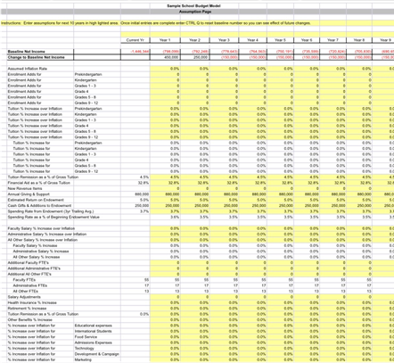
NBOA’s Long-Range Financial Model
The Long-Range Financial Model for Day Schools has several formulas in place that allow it to accurately predict your school’s budgetary projections. This easy-to-use, customizable ten-year budget model, available as an Excel spreadsheet, creates real-time forecasts for tuition, enrollment, FTEs, plant replacement and more. There is also a webinar to help familiarize yourself with the tool.

Slide 8
Enrollment Management Disruptors
Shifting Demographics
Politics
Changing Family Expectations
Technology
Your School
Shrinking Middle Class
Education Innovation
Increased Competition
Globalization
Source: The Enrollment Management Association

Slide 9
Children can’t come to school if they weren’t born.

Slide 10
Independent School Enrollment Change by Major Metro Area
2013-14 to 2017-18
National
14%
31%
42%
13%
Atlanta
19%
29%
48%
₅%
Boston
12%
26%
55%
₇%
Chicago
24%
18%
41%
18%
Houston
₇%
21%
50%
21%
Los Angeles
16%
24%
51%
₉%
Miami
11%
44%
33%
11%
High Decline
Moderate Decline
Moderate Growth
High Growth
Totals may not equal 100% due to rounding
Source: NAIS, Total Enrollment, DASL
New York
16%
29%
41%
14%
Philadelphia
18%
37%
34%
11%
St. Louis
14%
57%
21%
₇%
San Francisco
11%
18%
50%
21%
Seattle
₅%
14%
55%
27%
Washington, DC
-80%
14%
35%
37%
14%
-60%
-40%
-20%
0
20%
40%
60%
Source: NAIS 2018-2019 Trendbook
80%

Slide 11
Change in School-Age Population and
Change in Independent School Enrollment, 2010-2017
Seattle
■ +6.83%
■ +4.15%
WA
Chicago
■ -4.50%
■ +0.23%
MT
ND
VT
ME
Boston
■ +0.30%
■ 0.00%
OR
MN
NH
ID
SD
WI
NY
MA
WY
MI
CT
RI
New York
■ -2.74%
■ -4.72%
NE
IA
PA
NJ DE MD
San Francisco
■ +3.23%
■ +4.89%
NX
IN
OH
UT
CO
IL
WV
CA
KS
MO
KY
VA
Philadelphia
■ -3.34%
■ +5.73%
TN
NC
Los Angeles
■ -1.49%
■ +1.23%
AZ
OK
NM
AR
SC
Washington, DC
■ +3.29%
■ +3.66%
MS
AL
GA
TX
LA
Atlanta
■ +4.59%
■ -5.55%
AK
FL
St. Louis
■ -4.13%
■ -4.21%
Change in School-Age Population
Change in Median Independent School Enrollment
Source: NAIS, DASL and NAIS, Demographic Center
Houston
■ +8.78%
■ +2.41%
Miami
■ +2.80%
■ +1.41%
HI

Slide 12
Median Enrollment Change, by Grade Levels Served
2013-14 to 2017-18
Elementary
Schools
-2.3%
Median
Enrollment
Change
29%
31%
35%
₂%
-0.3%
Median
Enrollment
Change
Elementary/ Middle Schools
19%
32%
34%
15%
Elementary/
Middle/ Upper Schools
+0.8%
Median
Enrollment
Change
11%
34%
43%
12%
Middle/ Upper Schools
+1.9%
Median
Enrollment
Change
7
%
26
%
53
%
14
%
+2.2%
Median
Enrollment
Change
Upper Schools
9
%
21
%
52
%
17
%
60%
40%
20%
0
20%
40% 60%
High Decline
Moderate Decline
Moderate Growth
High Growth
Source: NAIS, Enrollment, DASL

Slide 13
SOTI Data
The competitive environment is taking its toll on enrollment outcomes.
Small schools are particularly vulnerable.
Enrollment’s influence in school wide decisions has not improved.
There is a significant gender divide in level of influence, salary, and leadership aspiration.
The stalled leadership pipeline needs action.
Enrollment/admission directors are taking the lead on retention in the midst of continued attrition increases.
The number of day schools enrolling international students continues to rise steadily; practices vary widely.
Enrollment/admission role varies widely in schools’ diversity missions.
Communications continue to shift from print to digital.
Source: The Enrollment Management Association 2018 State of the Industry Report
10. Opportunities abound to develop more data use expertise.

Slide 14
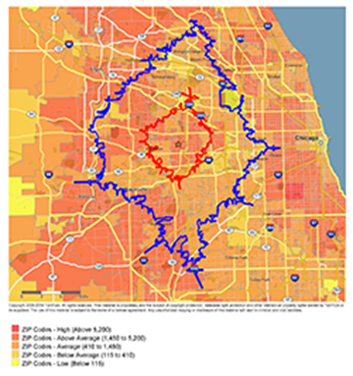
NBOA’s Demographic Data Service
Get powerful statistics on the neighborhoods surrounding your school. Access targeted data to clarify demographic patterns and trends in your area. This robust service provides customized reports, both current and projected, of population figures for your geographic location, including age, gender, and household income levels. Take advantage of this opportunity to review years of U.S. Census data in an accessible and compelling format, and glean important insights about your school’s target market.

Slide 15
Shifts in Supply & Demand Affecting Schools

Slide 16
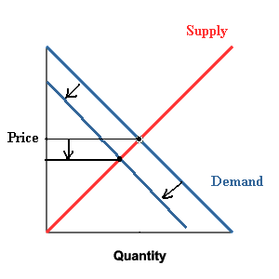
Falling Demand = Lower Price
+ Declining birth rate
+ Fewer families can afford private school due to wealth concentration
+ Delayed household formation due to student debt, changing attitudes
+
+

Slide 17
Rising Supply = Lower Price
+ Charter & Magnet Schools
+ Home Schooling
+ Micro Schools
+ Technology
+

Slide 18
Change in the School Economic Market Structure

Slide 19
Disruptors are Driving a Fundamental Market Transformation

Slide 20
Private School Market Structure has Shifted from Oligopoly to Monopolistic Competition

Slide 21
Oligopoly
What is it, and why is it used to describe the school market?
+ Limited number of market leaders
+ Interdependence, verging on collusion
+ High demand with limited supply and some barriers to entry

Slide 22
Monopolistic Competition
+ Many buyers and sellers
+ Firms offer products or services that are similar, but not perfect substitutes
+ Low barriers to entry and exit
+ Decisions of any one firm do not directly affect its competitors
+ Tend to advertise heavily

Slide 23
+ Price is based on supply and demand
+ Sellers cannot set market price, they can only adjust the supply to drive up demand for limited units
+ Schools cannot “set tuition”!
+ The old-school market oligarchs had partial price power, but there are now fewer customers and more competition
+ Schools have maintained the illusion of setting price (tuition) by increasingly heavy discounting (generous financial aid & merit scholarships)
+ Pressure will push price downward as new competition enters a market with stagnant or declining demand
Monopolistic Competition Pricing

Slide 24
Want vs. Need
“There is a big difference between a family’s ability to pay and their willingness to pay. A family’s willingness to pay is multivariate – from how much they value what you are offering, to the quality of alternatives, to how many children they have, to how much they value making other consumer goods purchases.”
“The Role of Price in Enrollment Management” Enrollment Management Association Special Report

Slide 25
Key Question:
How do we structure a market-based price individually across the customer base?

Slide 26
Price Discrimination
+ Charging customers different prices for identical goods or services, according to certain criteria.
+ In pure price discrimination, the provider will charge each
customer the maximum price they are willing to pay.

Slide 27
Pricing and Financial Aid in Today’s Changing Landscape

Slide 28
The Future of Financial Aid
+ Independent school discount rate* was 17.5% according to NBOA (*FA, scholarships, and remission, 2016-17)
+ The college bellwether
86% of first time freshmen received some kind of aid (2014-15)
Total grant dollars equal nearly 50% of gross tuition/fee revenue for first time (2017-18)
+ Growing inequality in the U.S. has dramatically impacted retail. The bottom 90% has only 20% of the wealth, while the top 1% has upped its share to 40%
Sources: Axios; Christensen Institute, NACUBO

Slide 29
How to Structure Financial Aid?
+ Traditional need-only tuition aid
+ Flex tuition – based on ability
+ Cut the list price and dramatically scale back aid
+ Offer a mix of traditional need-based aid and merit scholarships
+ Need-based aid for full cost of attendance
Needs to start with the mission and have strategic direction

Slide 30
November/December 2018
NBOA Magazine
Case Study:
Saint John’s Preparatory School

Slide 31
Case Study:
Saint John’s Preparatory School
Location: Collegeville, Minnesota Founded: 1852 “a shade older than the
state of Minnesota”
Enrollment: 275 students Program: Day-Boarding, Grades 6-12 Budget: $6 million 2012: Complete separation from
Abbey, $2M endowment

Slide 32
Case Study:
Saint John’s Preparatory School
“We were a 160-year-old toddler learning to take our financial first steps.” Sherry Krebsbach, Executive
Director, Finance & Facilities
The Bottom Line To stand on its own after 160 years of financial sponsorship, and facing a certain enrollment decline, Saint John’s Prep organized and analyzed its finances around six specific categories for revenues and expenses.

Slide 33
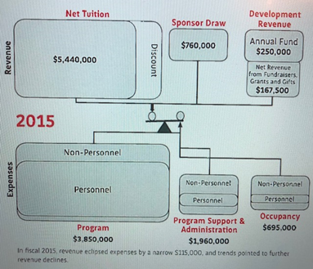
Saint John’s Prep Case Study:
Embracing Change: Assess, Decide, Act
Revenue Levers: 1. Net Tuition Revenue: a) Sought “fiscally sustainable and highly retainable” students. b) Identified empty seats and filled them through variable tuition, their need-based assistance program. c) Adopted a school-wide “everybody, everyday” admissions focus. 2. Sponsorship Funding: a) Adjusted expenses to target reduced 4.5% annual endowment draw to achieve a balanced budget. b) Re-calibrated scholarship funding to support mission-appropriate students. 3. Development: a) Eliminated “walls” that separated development program from the rest of the school. b) Invested in staff and services and increased accountability for bottom-line results.

Slide 34
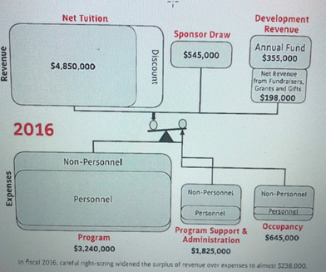
Saint John’s Prep Case Study:
Embracing Change: Assess, Decide, Act
Expense Levers: 1. Program: a) Identified “non-negotiables” such as core requirements. b) Assessed per class enrollment and time requirements of elective courses. c) Ensured non-teaching positions were not compensated on faculty pay scale. d) Leveraged know attrition for advanced planning of FTE ratios. 2. Administration & Support: a) Evaluated job descriptions and combined certain skill requirements to both reduce FTE’s and remove department silos. b) Centralized communications to one position. c) Outsourced food services and IT management.
3. Occupancy: a) Conducted a plant assessment and identified urgent needs. b) Outsourced custodial services for widened skillsets and greater nimbleness for future years.

Slide 35
Flexible Tuition:
Indian Creek School (MD)
+ Flexible Tuition Model established in FY 18 to boost transparency
+ Helps families see quickly what they would pay based on income
+ Affordability language helps demystify the process
+ Less burdensome income information
Linda Dennison
Chief Financial Officer
Source: The Enrollment Management Association Podcast : enrollment.org/podcast

Slide 36
FIT Program: Gordon School (RI)
+ FIT = Family Individualized Tuition
+ Commitment to diversity and culture,
no mention of “financial aid” with families
+ 3-yr price set for families (so that they can plan)
+ Individualized income-based plan for each family
+ No “discounting”
Noni Thomas Lopez
Head of School
Source: The Enrollment Management Association Podcast : enrollment.org/podcast

Slide 37
Discounting Tuition: Montgomery School (PA)
+ Discounted tuition by one-third for FY19
+ In just 6 months, Montgomery School has grown by 30 students (from 220 to 250)
+ All families received the discount
+ Wealthy families were asked to donate the difference
+ Over $1 M in new donations
+ The largest percentage of new students at Montgomery come from public schools
Sally Keidel
Head of School
Source: The Enrollment Management Association Podcast : enrollment.org/podcast

Slide 38
The CFO’s New
Most Important Partner

Slide 39
The Power of Partnership
The enrollment officer and business officer jointly support the school’s decisions and advance its financial sustainability. To ensure partnership, translate your business-oriented expertise into:
Competitive intelligence made accessible, compelling, and actionable
Demographic data to inform trustees who are focused on the future
Current year statistics for a constant finger on the pulse of the school
Leadership-wide awareness of the net tuition target in order for enrollment partners to manage enrollment and financial aid to reach that number
Notes:
JEFF:
“Remember that you possess competitive intelligence that is critical to your school’s future success. Collect and codify it to answer these two all-important questions: Why do your families choose your school? Why do other families choose a school down the street? Frame the information in a way that is accessible, compelling, and actionable for your colleagues. Break it down into a table, chart, or graph. Make your data ‘tell a story.’
“Be the ‘keeper’ of demographic data for your school’s market. Trustees are focused on the future, and your ability to describe and forecast the next generation of students will make you an invaluable partner to them…
“Keep the current year admission statistics (number of applications, visits, waitlists, etc.) top of mind so that others have no doubt that you are the expert and your finger is on the pulse of the school!
[Note: This excerpt doesn’t include Jeff’s fourth tip on net tuition / financial aid, as it is not as relevant to international school admission offices.]
The admission officer and the business officer have a great deal in common in their ability to support the school’s decisions and advance its financial sustainability. Translate your expertise into language he or she understands and appreciates, and you’ll be invaluable partners as well.”

Slide 40
How the Role of the Admission Director is Changing

Slide 41
It’s Not Admission Anymore!
© Tew & Associates

Slide 42
It’s Not Admission Anymore!
Gatekeeper Era
CO Era
Cruise Director Era
Headmaster Era

Slide 43
Why Does it Matter?
Enrollment is the area of the school that transcends all three
Policies | Time and Attention Graph
Strategies
Mission | Board’s Decisions
Leadership | Head’s Advice
Partnership
Authorizations
Finance policies | Shared Decisions: Board/Head
Enrollment
Employment terms
Operational
Admission | Board’s Advice
Program | Head’s Decisions
Richard Chait, Harvard Graduate School of Education

Slide 44
The Admission Director’s Job
Hit this target while also:
Controlling for mission and fit
Controlling for size
Balancing marketplace realities of uneven demand for seats
Gross Tuition Revenue
Attributes
Grade Levels
Gender Diversity Feeder Schools Siblings, New Faculty Kids
↑
Margin
Impact
$$$
Distinction GPA/Scores
Athletes, Artists, etc.
←Mission
Mission→
Margin
↓
Net Tuition Revenue
(Discounting)
Source: David Kalsbeek, USC Enrollment Management Leadership Program

Slide 45
Why Does it Matter?

Slide 46
Retention
The easiest student to enroll is one you already have.
+ Operationalize retention efforts and the collection and analysis of data.
+ The head of school must set the example.
Source: The Enrollment Management Association,“Being Intentional About Retention,” The Yield, Winter 2017-18

Slide 47
You Can’t Fill A Leaky Bucket
New England Schools: 8.9% Mean Attrition
+ Connecticut: 9.6%
+ Massachusetts: 8.4%
+ Maine: 10.3%
+ New Hampshire: 7.5%
+ Rhode Island: 9.4%

Slide 48
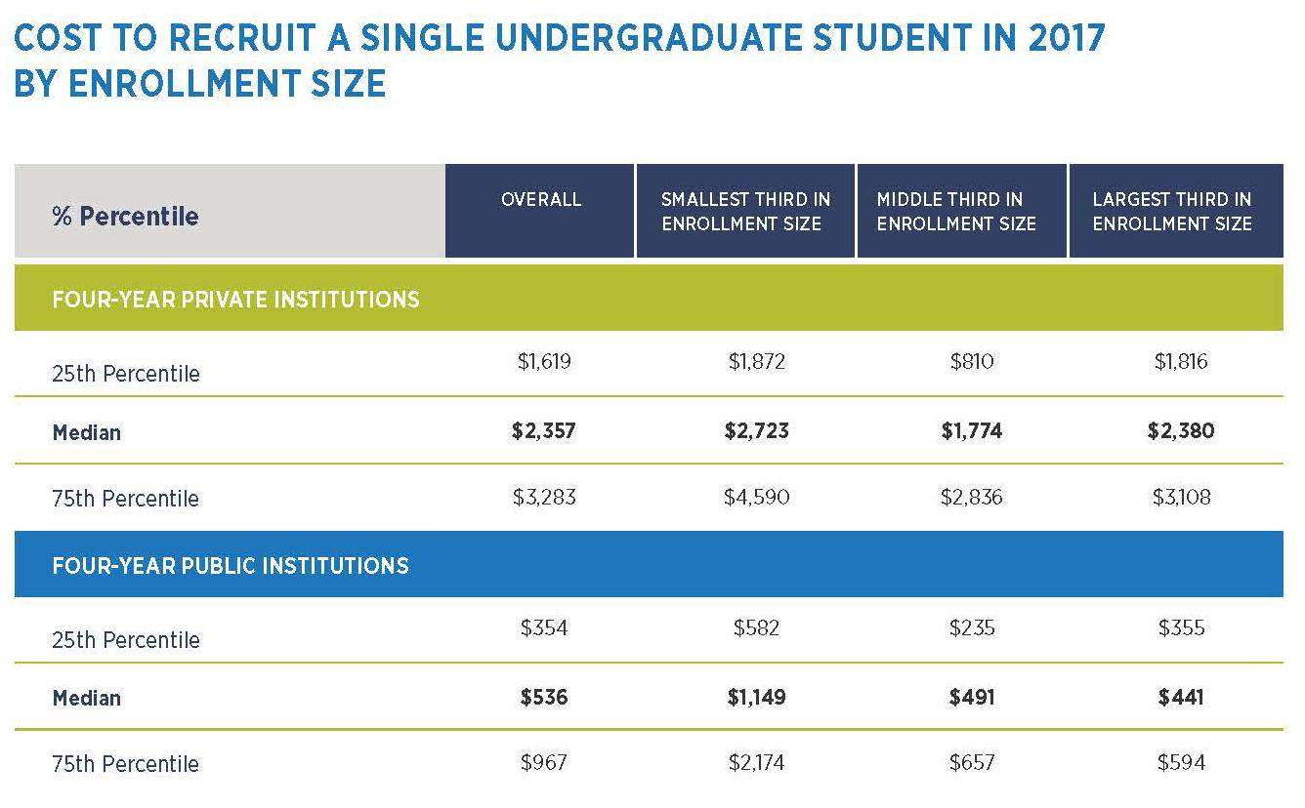
How much does it cost to enroll a student?
Source: © 2018 Ruffalo Noel Levitz | 2018 Cost of Recruiting an Undergraduate Student Report
http://bit.ly/RNLCosttoEnroll

Slide 49
Chief Revenue Officer Responsibilities

Slide 50
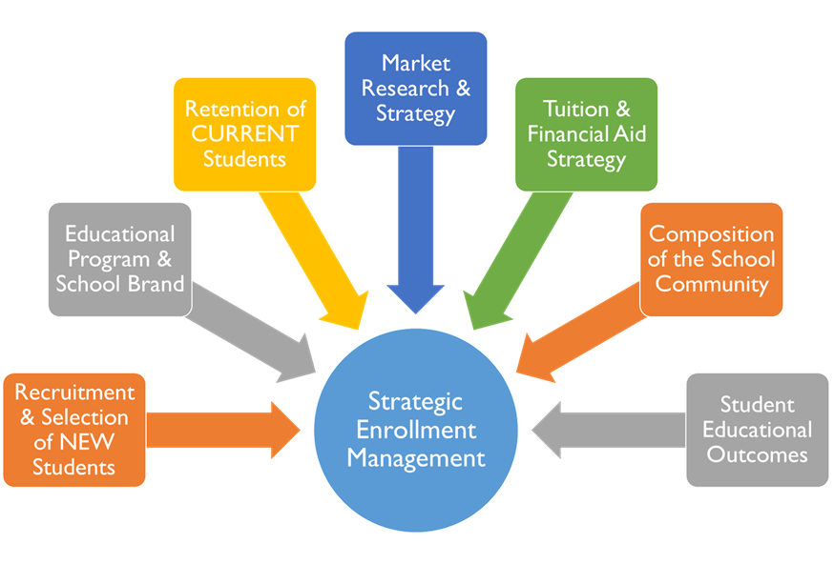
Source: The Enrollment Management Association

Slide 51
The Enrollment Manager:
Your chief revenue generator and a key strategic partner.
+ Develops competitive enrollment strategy within a culture of evidence
+ Advances the school’s competitive position
+ Provides strategic and tactical leadership for admission, financial aid, retention tracking

Slide 52
Examples of Enrollment-Related KPI Basics

Slide 53
Top three reasons why families choose your school
Top three reasons why they don’t
Top three crossovers/competitors
Win-loss record with overlap schools
Yield by category of student
Why do families leave your school?
Source: The Enrollment Management Association

Slide 54
Source: The Enrollment Management Association

Slide 55
Source: Viewpoint School

Slide 56
Source: Viewpoint School

Slide 57
ACCEPTED FOR ADMISS ION BUT DECLINED
Decision Process: Reasons Families Did Not Choose to Enroll at Viewpoint
"He wanted a school that was closer to our house [...)
Viewpoint i s superior in every
regard other than location."
Oiart diepicts answe to the question "Please select the MAIN re:iscn{s} you choose not to erYoll ifl V.ewpornt SChool... Families could make up 10 three
seleaions.
2017-18 Non-Enrollee
Survey Results
1.II
• • • • ₋ ₋ ₋
ih follov-up question r'eque-Sttd a
narrative response. Themes indutl ed laments about diStance, choos.ing to s.1ay with friends.,
following siblings, sele-cting .ijlSchool
for' reliirio rea on.or optinr: for
boa rding s.chool.
O F F I CE OF ADMISS ION
m
VI EWPOI NT
SCHOOL
Decision Process: Characteristics Families Assoc iate with Viewpoint Compared to the Schools Where They Enrolled
Chart represents: OJ compa r ison in
respo nses. to lwo questions :
"The following is a list of fmages
or dlaracteristics p op1tl
ii155Dc1 ate. with ooh;_ PIHSH
s.el@Ct up to three- yo1.1 a')soclate
with View ooint"" lDLUEJ
III I
.III
•nd
•·•• II
'"The followlng Is a llst of rmages or ctiaracterisl:iC$ people associate with schools.Please
5elec.t up to th ,tevou auo,late
with the s:clioolin whkh you will
•nroll." IGRCCNI
Source: Viewpoint School

Slide 58
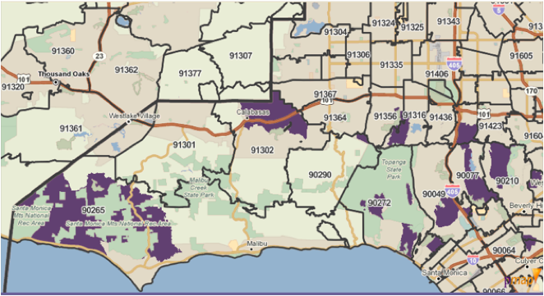
Demographic Data Mapping
High-earning households that also have entry-age kids
Source: Viewpoint School

Slide 59
Median Salaries for Administrators in Independent Schools
AISNE NAIS Data 2017-18
$300,000
$300,000
$261,806
50% more than Director of Admission!
$250,000
$250,000
$230,000
20% more than Director of Admission!
$200,000
$200,000
$166,400
$157,450
$150,000
$150,000
$130,000
$109,032
$104,500
$100,000
$88,630
$87,585
$82,020
$100,000
$91,700
$88,190
$50,000
Head of School
Chief Business Manager
Director of Development
Source: NAIS Facts at a Glance 2014-2015
$50,000
Head of School
Chief Business Manager
Director of Development
Director of Admission
Director of Technology
Athletic Director
Director of Admission
Director of Technology
Athletic Director
0
0

Slide 60
CONTINUING EDUCATION CREDIT CHECK-IN CODE
CODE
Thank You! Questions?

Slide 61
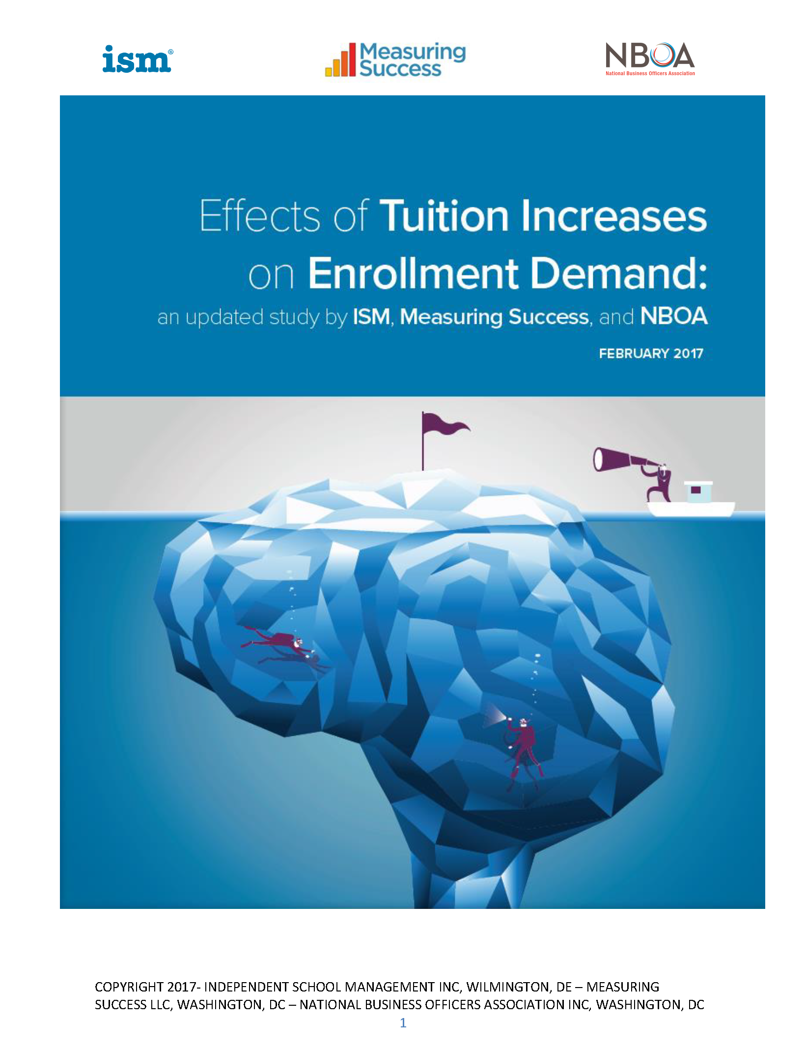
“Overcommitted: The Future of Financial Aid“
“Overcommitted: The Future of Financial Aid“
from the Nov/Dec 2018 issue of Net Assets magazine
from the Nov/Dec 2018 issue of Net Assets magazine
https://go.nboa.org/Overcommitted
https://go.nboa.org/TuitionPricingWhitepaper
“What Every Business Officer Needs to Know About Enrollment Management — a Conversation”
from the Nov/Dec 2018 issue of Net Assets magazine
https://go.nboa.org/NeedToKnow
Source: National Business Officers Association, www.nboa.org | www.netassets.org

Slide 62
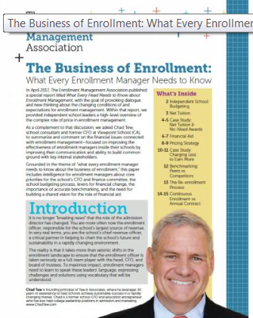
http://bit.ly/EvolutionISAP
https://enrollment.org/soti16
*PAGE 18 has focus on “What every admission director needs to bring to the table!”
http://bit.ly/RiseSEM
http://bit.ly/EMASeatTable
https://enrollment.org/ businessofenrollment
Source: The Enrollment Management Association, www.enrollment.org

